Slide 1
App Store Selection
Selecting the Optimal App Store Platform for Your Product Offering!

Slide 2
Project Overview
There are a variety of major app stores available for new products with the primary two being Google & Apple’s respective platforms
While both app stores seemingly offer the same types of solutions, the disparity of apps, variability of user reviews, and customer engagement across both platforms may result in one platform leading to superior product traction
We had drilled into app store reviews and user engagement to see if there is a significant difference in ratings between the two platforms and, if so, which platform you should host your product on!

Slide 3
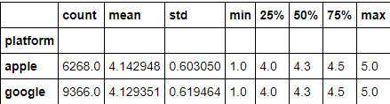
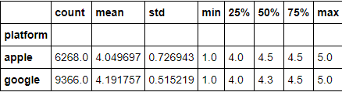
Findings
We reviewed the ratings and reviews across all apps listed in the app stores for both Google and Apple to see if one platform lead to higher reviews
Initial data set implied no difference in ratings across platforms; however, the data was not normally distributed. When standardizing the data, google’s data set is shown to having statistical significance in leading to higher reviews
Initial Data
Permuted Data

Slide 4
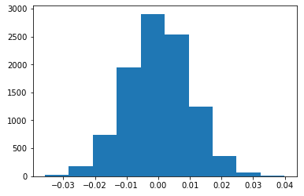
Conclusion
Based on the findings that Google’s platform leads to higher average ratings, we recommend that you upload your app onto Google’s app store as it gives the best chance of leading to the highest user review
Absolute Rating Difference of Google vs. Apple reviews
Favors Apple
Favors Google

